Slide 1
Neural Ordinary Differential Equations
Rodrigo Arrieta
18.337 Spring 2023

Slide 2
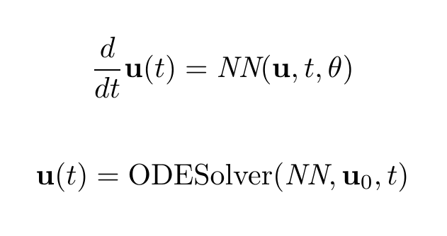
What are Neural Ordinary Differential Equations (Neural ODEs)?
Neural ODEs is a class of neural networks that, instead of modeling the data directly, it models the derivative of the data.
An ODE solver is required to the predicted data from the modeled derivative.
They can be understood as the continuum limit of Recurrent Neural Networks (RNNs).

Slide 3
Why are they useful?
They are useful to model continuous time-series data.
Neural ODEs do not “learn the data”, which could be complicated, they “learn” the latent dynamics of the system. That’s how physics works!
Useful in modeling physical, financial, and biological systems when theory-driven models are lacking or non-existent.

Slide 4
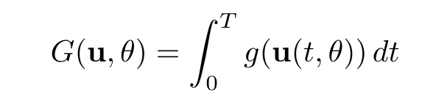
Backpropagation
We really do not want to backpropagate through the steps of the ODE solver: too expensive!
Instead, we can use the adjoint method to compute the gradient of the cost w/r to weights.
Cost:

Slide 5
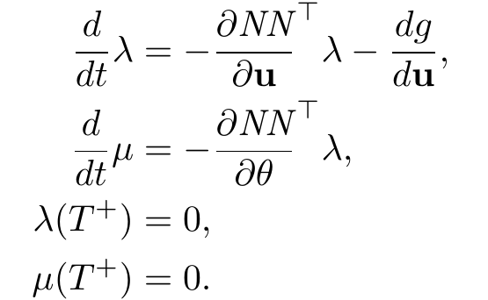
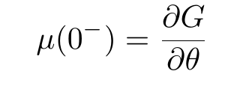
Backpropagation
Cost:
First, we solve the ODE forward, from 0 to T.
Second, we solve the adjoint ODE backwards, from T to 0.
The gradient is then:

Slide 6
My project
I implemented my own Neural ODE adjoint solver from scratch, fully compatible with Flux.jl
In the next slides I’ll present some examples of interests.

Slide 7
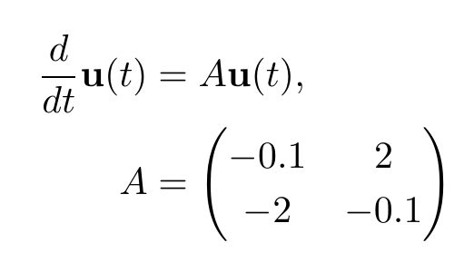
Example 1: Linear system
Trained the NN for a fixed interval [0,1] and various random initial conditions.
NN: 1 hidden layer, 64 hidden units

Slide 8
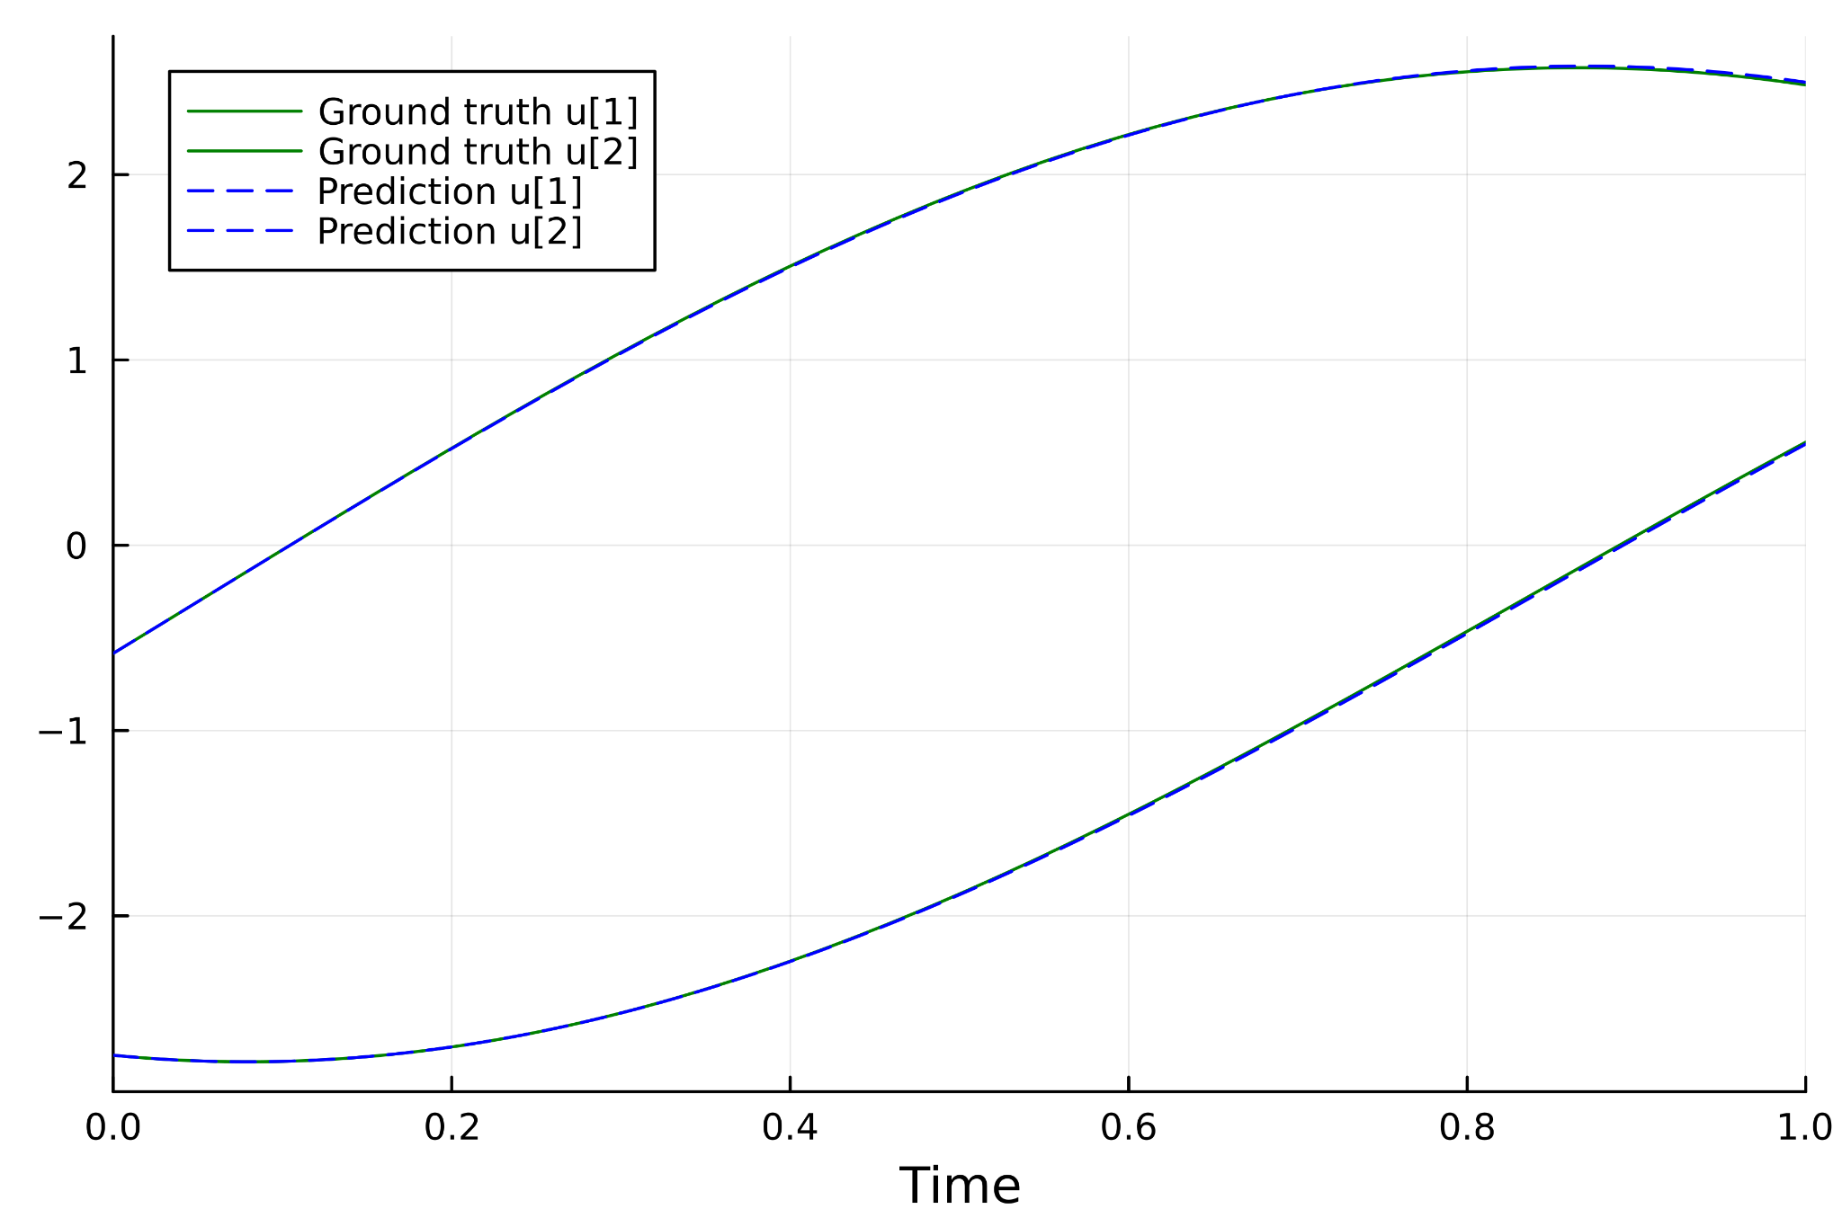
Example 1: Linear system

Slide 9
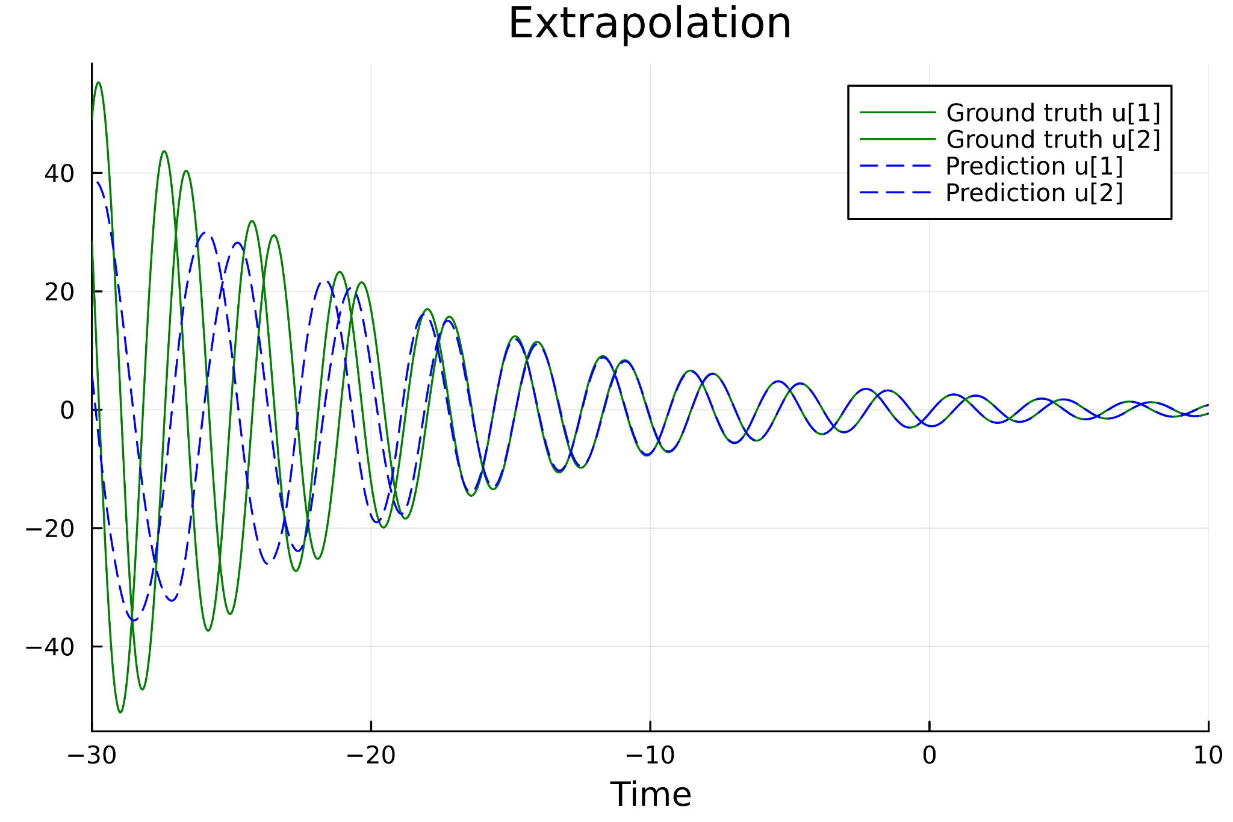
Example 1: Linear system

Slide 10
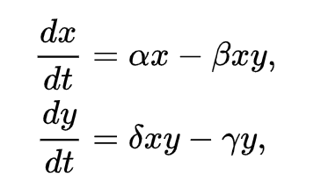
Example: Lotka-Volterra eqs.
Trained the NN for a fixed interval and initial cond.
This is a nonlinear system with periodic behavior.

Slide 11
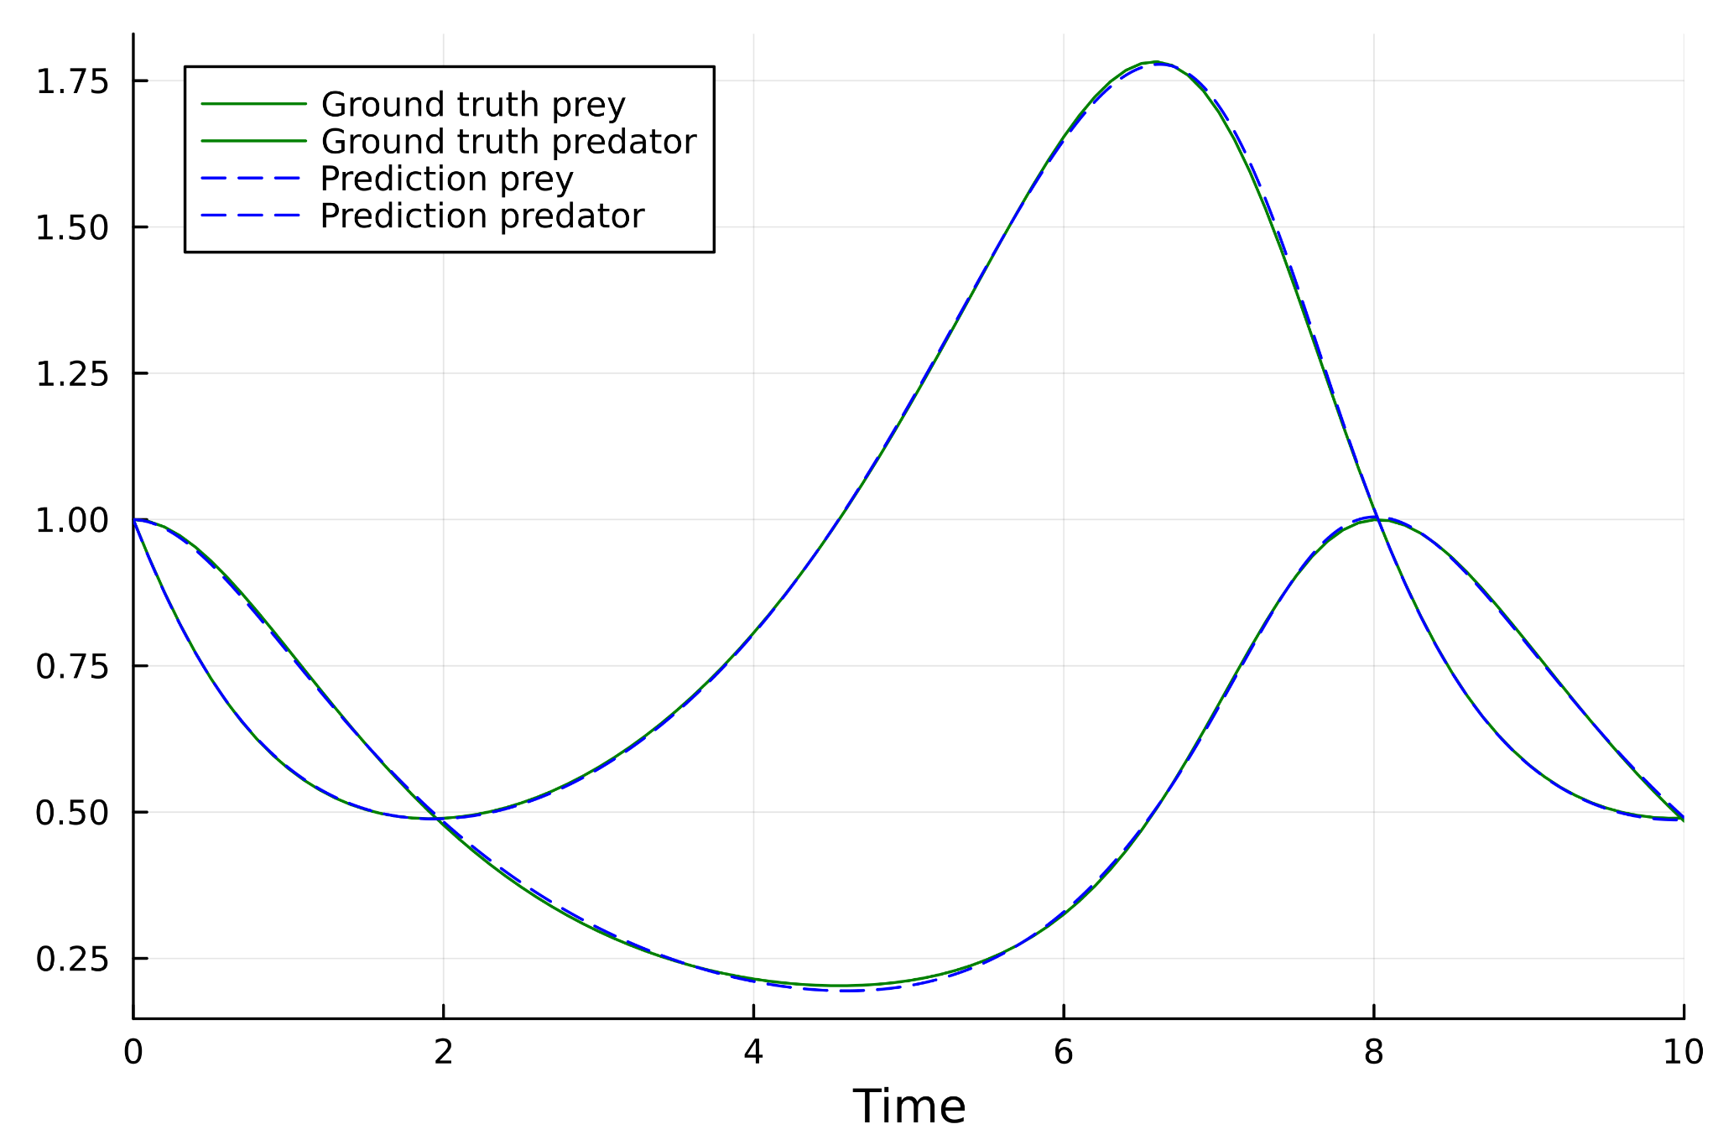
Example: Lotka-Volterra eqs.

Slide 12
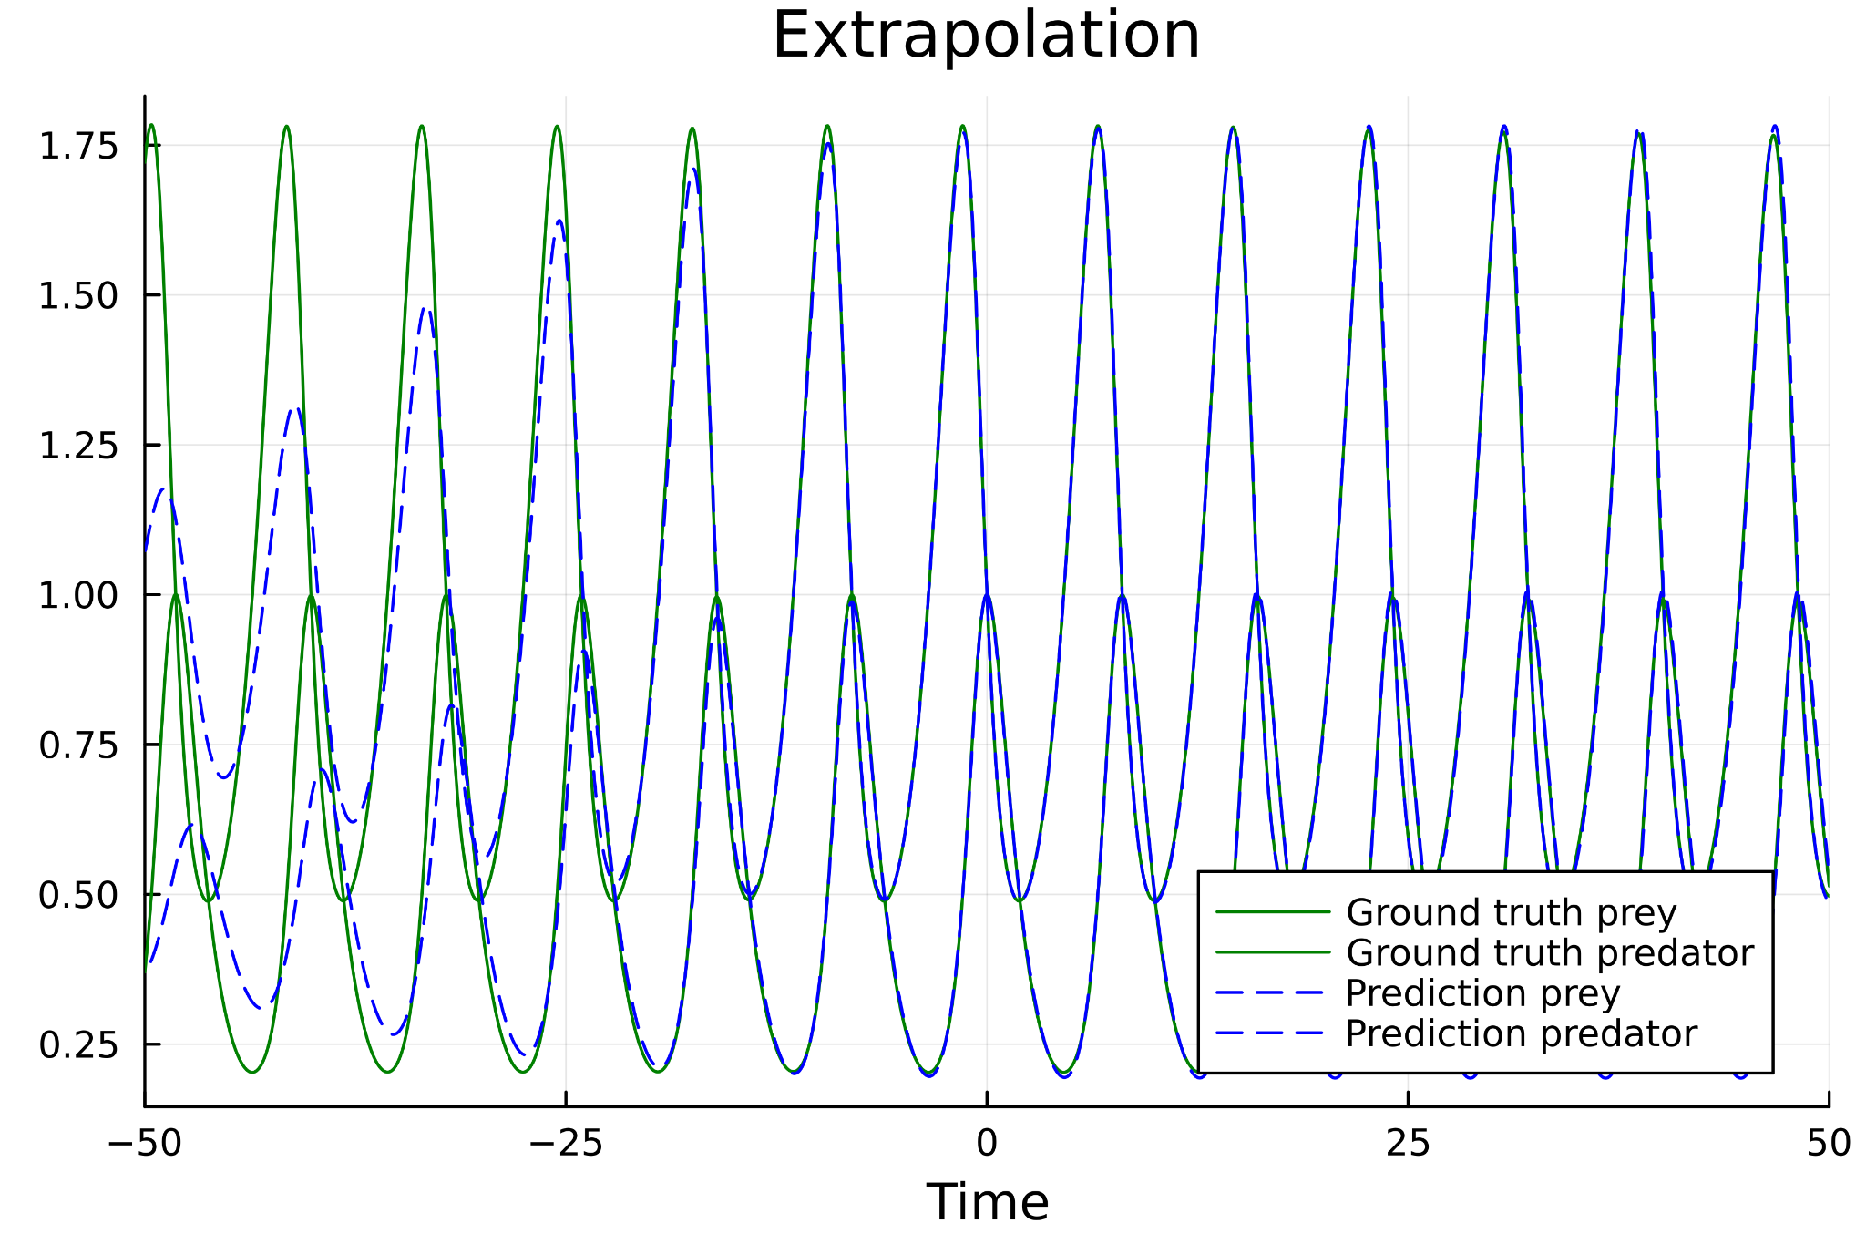
Example: Lotka-Volterra eqs.

Slide 13
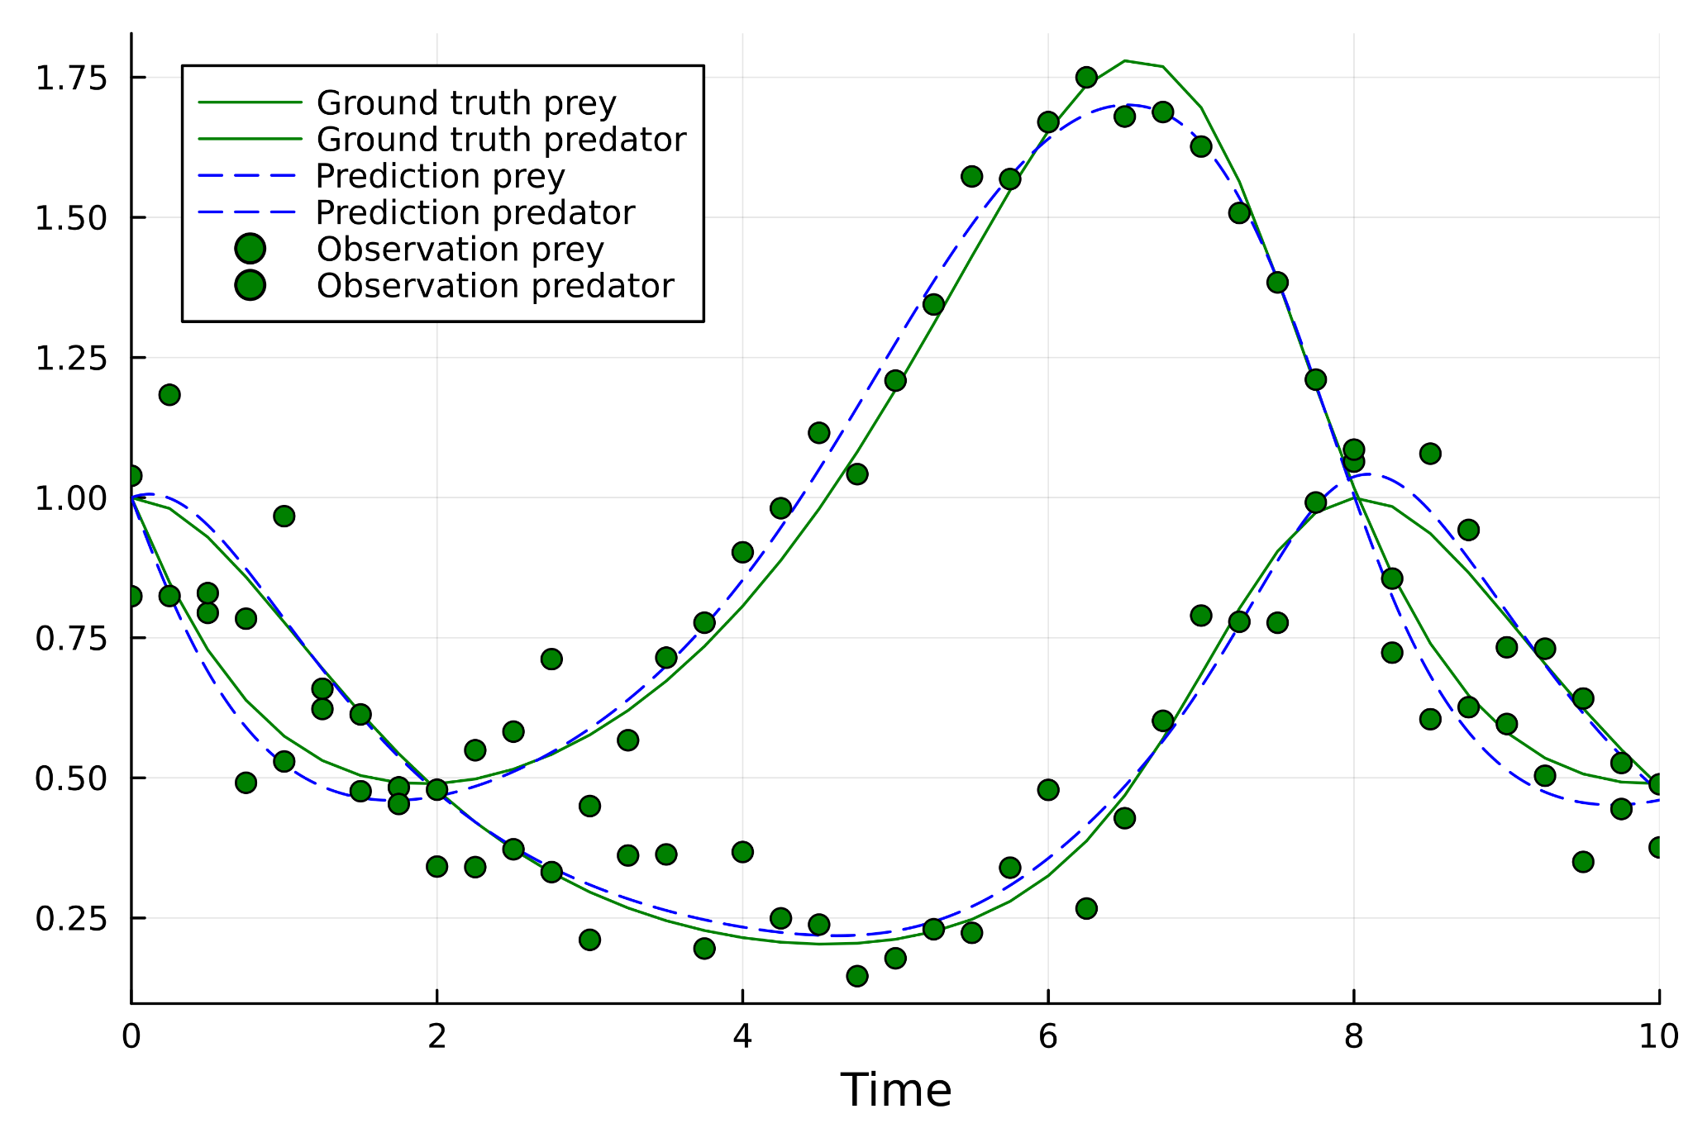
Example: Lotka-Volterra eqs., with noise

Slide 14
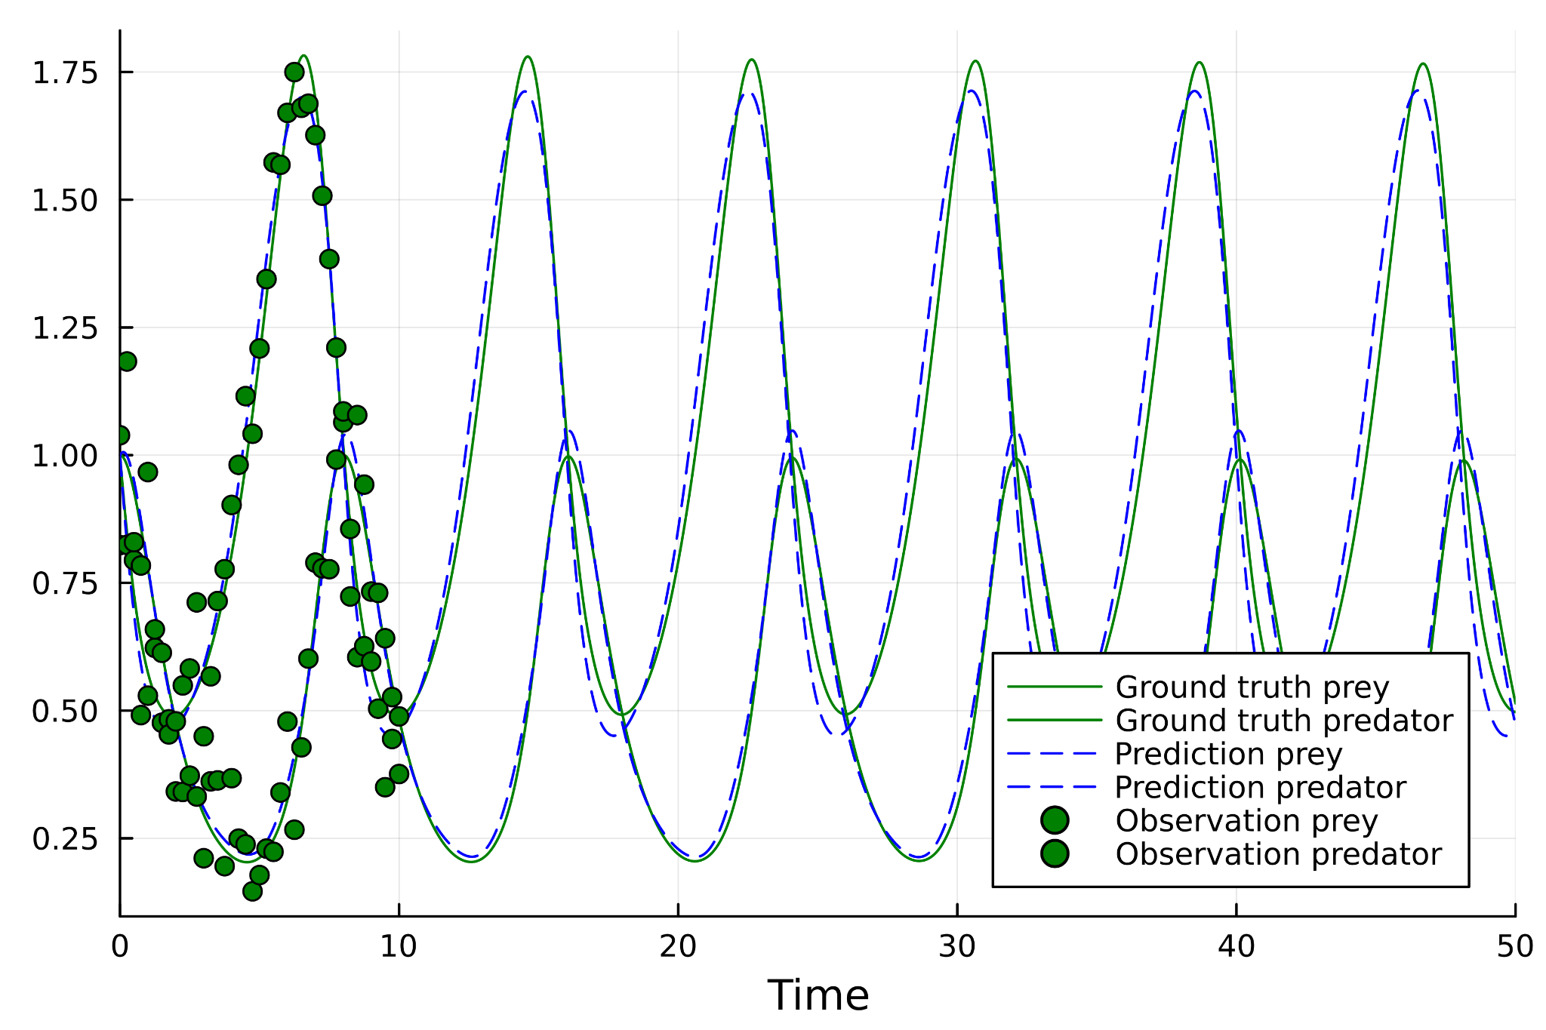
Example: Lotka-Volterra eqs., with noise

Slide 15
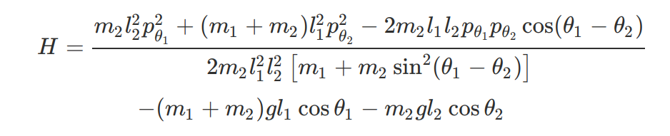
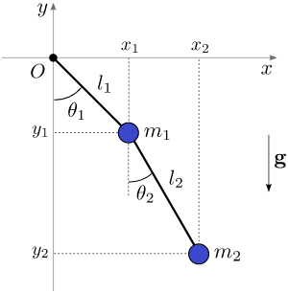
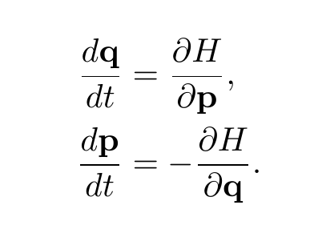
Example: double pendulum
Trained the NN for a fixed interval and initial cond.
This is a nonlinear system with aperiodic behavior.

Slide 16
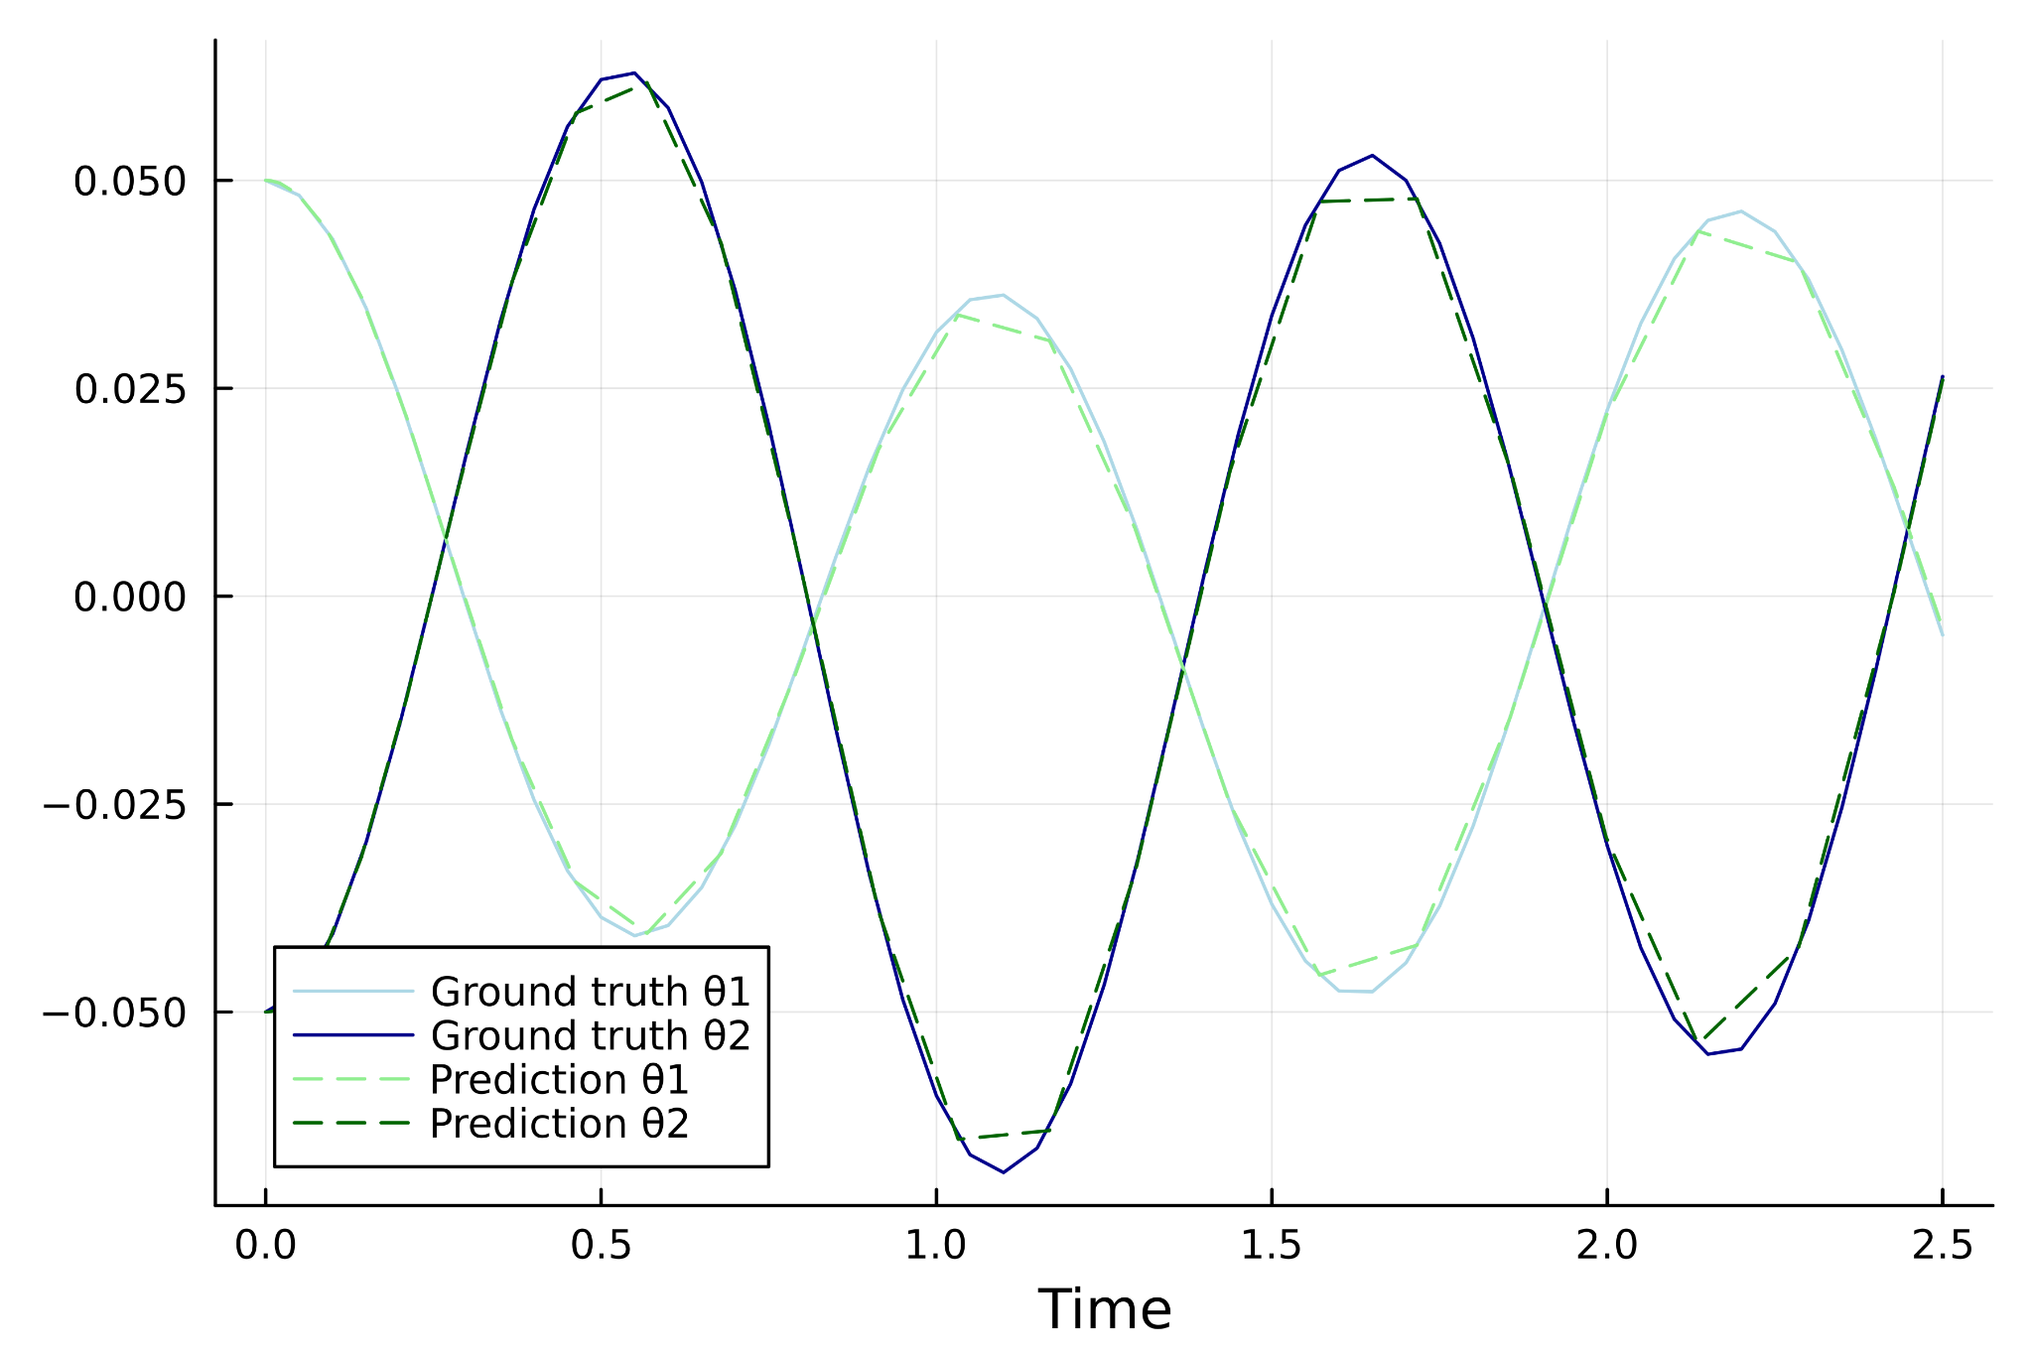
Example: double pendulum

Slide 17
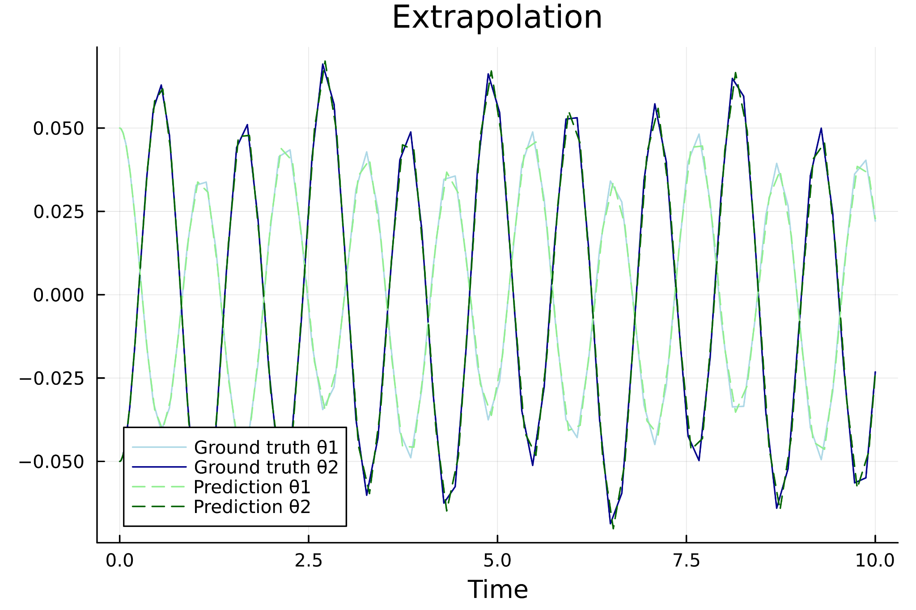
Example: double pendulum

Slide 18
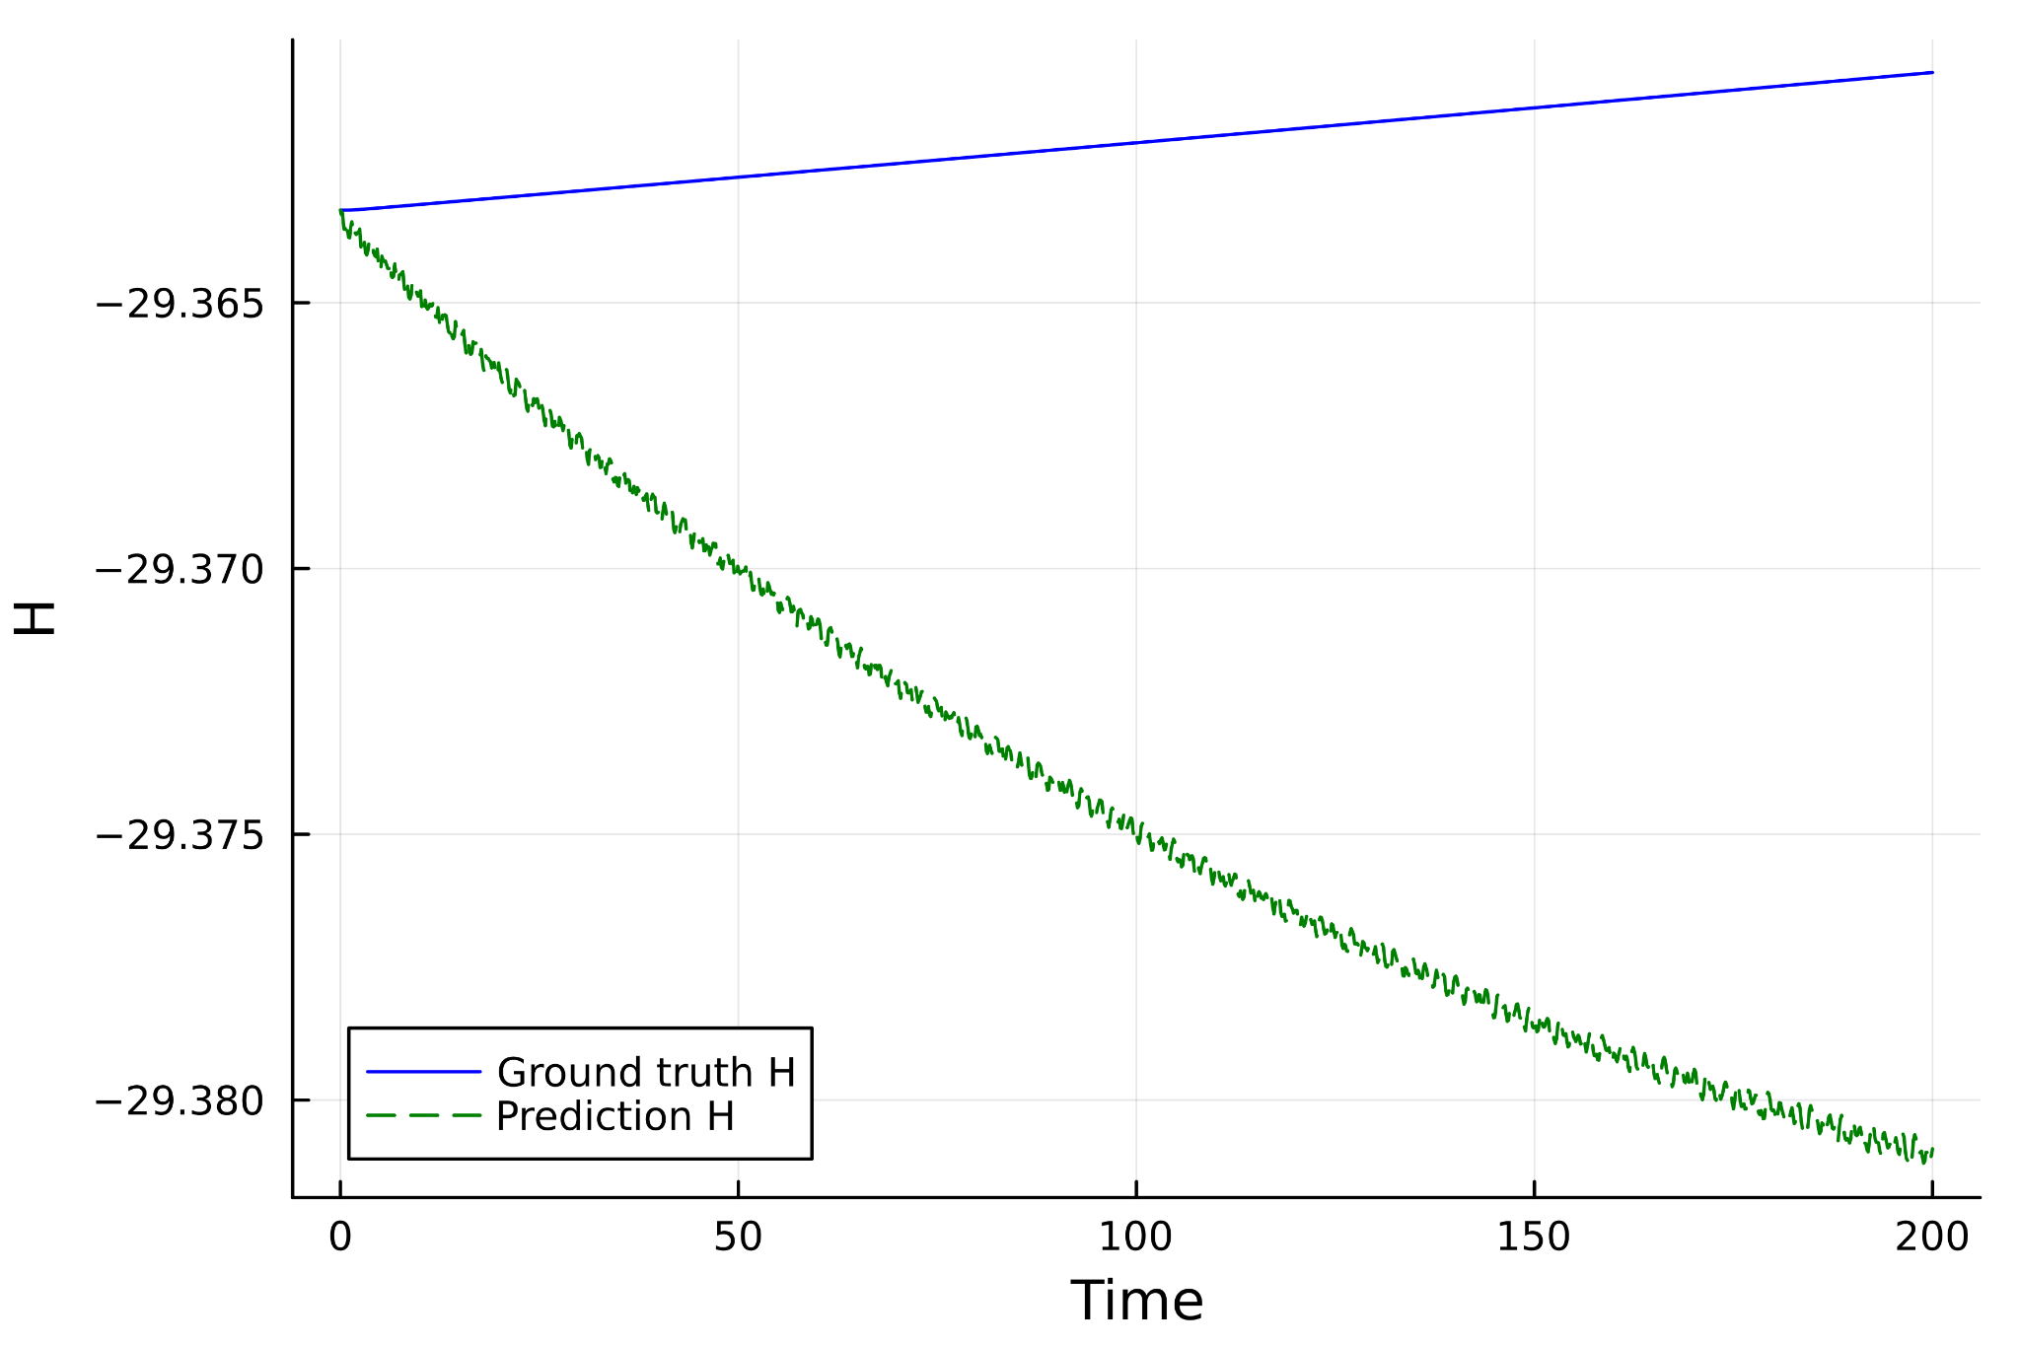
Example: double pendulum

Slide 19
Solution: Hamiltonian Neural Networks (HNNs)!
The NN models the Hamiltonian instead of the derivative of the system.
I implemented HNNs using DiffEqFlux.jl.

Slide 20
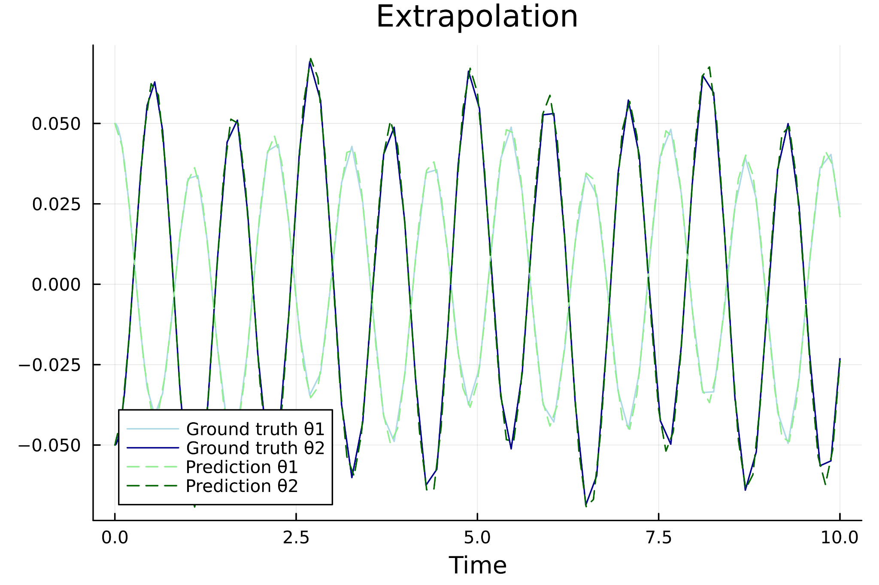
Example: double pendulum with HMMn

Slide 21
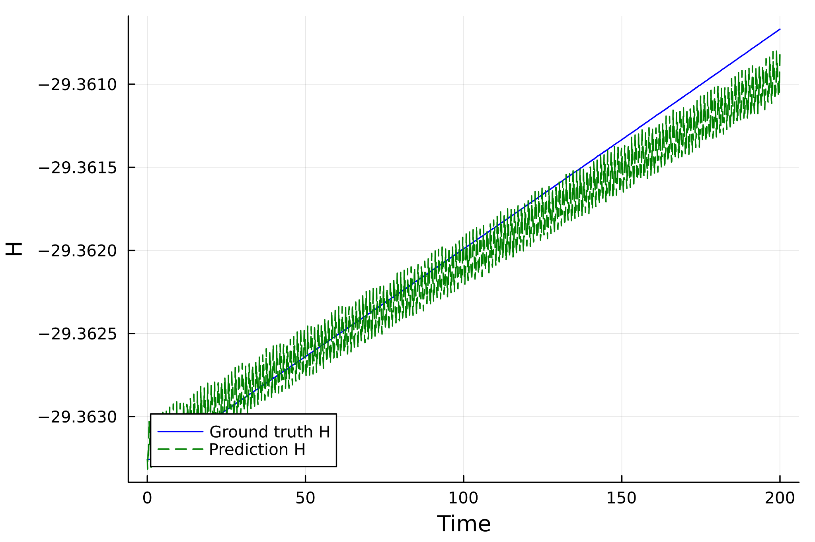
Example: double pendulum with HMMn

